Slide 1
Ambiguity Resolution in Grammar Parsing: Designing Software for Precision Parsing
Ambiguity occurs when a sentence or phrase can be interpreted in more than one way.
Common parsing algorithms include top-down parsing, bottom-up parsing, and chart parsing.
Natural Language Processing (NLP) applications, such as machine translation, speech recognition, and information retrieval.
Syntax checking and correction in word processors and code editors.
Accuracy: Measuring the correctness of parsing outcomes against annotated corpora.
By
R. Tejesh(192211597)
T.Abhinav(192211688)

Slide 2
Challenges in Precise Parsing
1
Lexical Ambiguity
2
Syntactic Ambiguity
Single words can have multiple meanings, creating confusion.
Sentence structure can be interpreted in different ways.
3
Contextual Dependency
Meaning depends on the surrounding text and situation.

Slide 3
Techniques for Resolving Ambiguity
Syntactic Rules
Semantic Analysis
Probabilistic Models
Leveraging grammatical constraints to rule out invalid interpretations.
Using meaning and context to choose the most plausible parse.
Applying statistical techniques to assign likelihood to different parses.

Slide 4
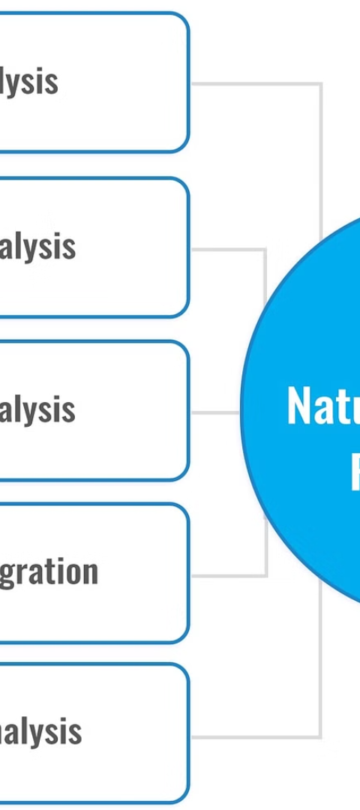
Leveraging Context and Semantics
1
Anaphora Resolution
Identifying references to previous entities in the text.
2
Discourse Analysis
Examining the flow and structure of the language to infer meaning.
3
World Knowledge
Applying common sense and domain-specific information to disambiguate.

Slide 5
Probabilistic Models for Ambiguity
Hidden Markov Models
Bayesian Networks
Modeling the underlying structure of language to predict most likely parses.
Representing dependencies between linguistic elements to reason about ambiguity.
Neural Networks
Ensemble Methods
Leveraging deep learning to learn patterns and representations from data.
Combining multiple models to increase robustness and accuracy.

Slide 6
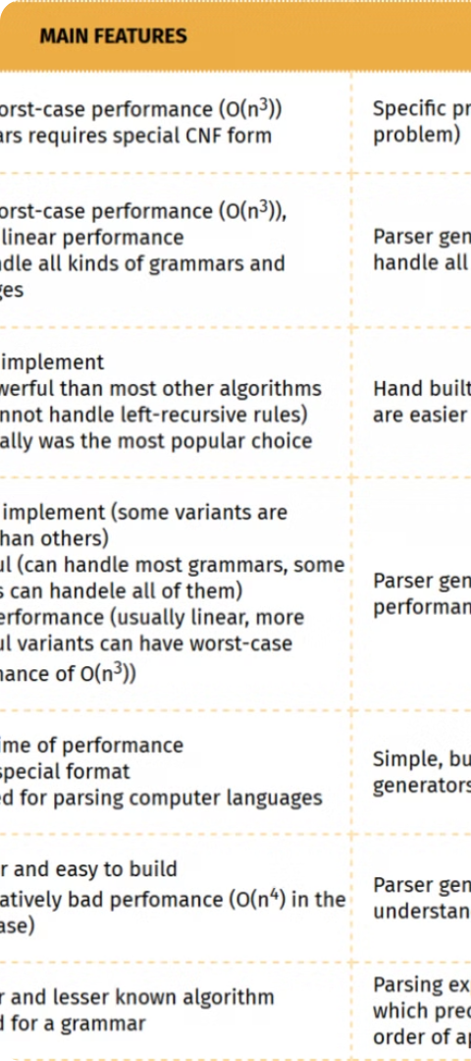



Designing Robust Parsing Algorithms
Modular Design
Separating concerns like tokenization, syntax analysis, and semantic interpretation.
Error Handling
Gracefully handling unknown input and partial parses to avoid failures.
Efficient Computation
Optimizing parsing algorithms for speed and scalability.

Slide 7




Evaluating Parsing Accuracy
Precision
Recall
F1-Score
Latency
Measures how many of the returned parses are correct.
Measures how many of the possible correct parses are found.
Combines precision and recall into a single metric.
Measures the time taken to complete the parsing process.

Slide 8

Conclusion and Future Directions:
Ambiguity resolution is a fundamental challenge in grammar parsing that requires a combination of syntactic, semantic, and probabilistic techniques. As language models and computing power continue to advance, we can expect to see even more accurate and efficient parsing algorithms in the future.

